Slide 1
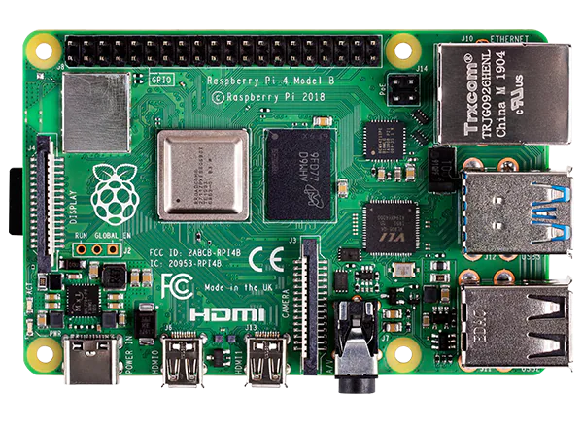
RAM(1GB, 2GB, 4GB)
GIGAbit Ethernet
Powerful procesor
USB Port
USB-C Power supply
Micro HDMI Ports

Slide 2
Board: BCM2711
CPU: ARM
RAM: 4GB(SDRAM)
OS: Raspbian
USB: 3.0Ports, 2.0Ports
Bluetooth: 5.0
Ethernet: Gigabit
Pin: GPIO
BCM BASE: 0xFE200000

Slide 4
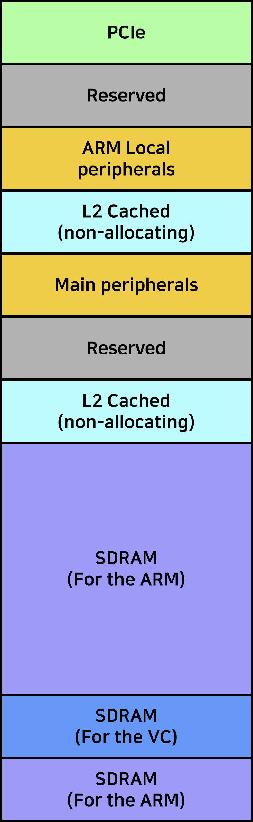
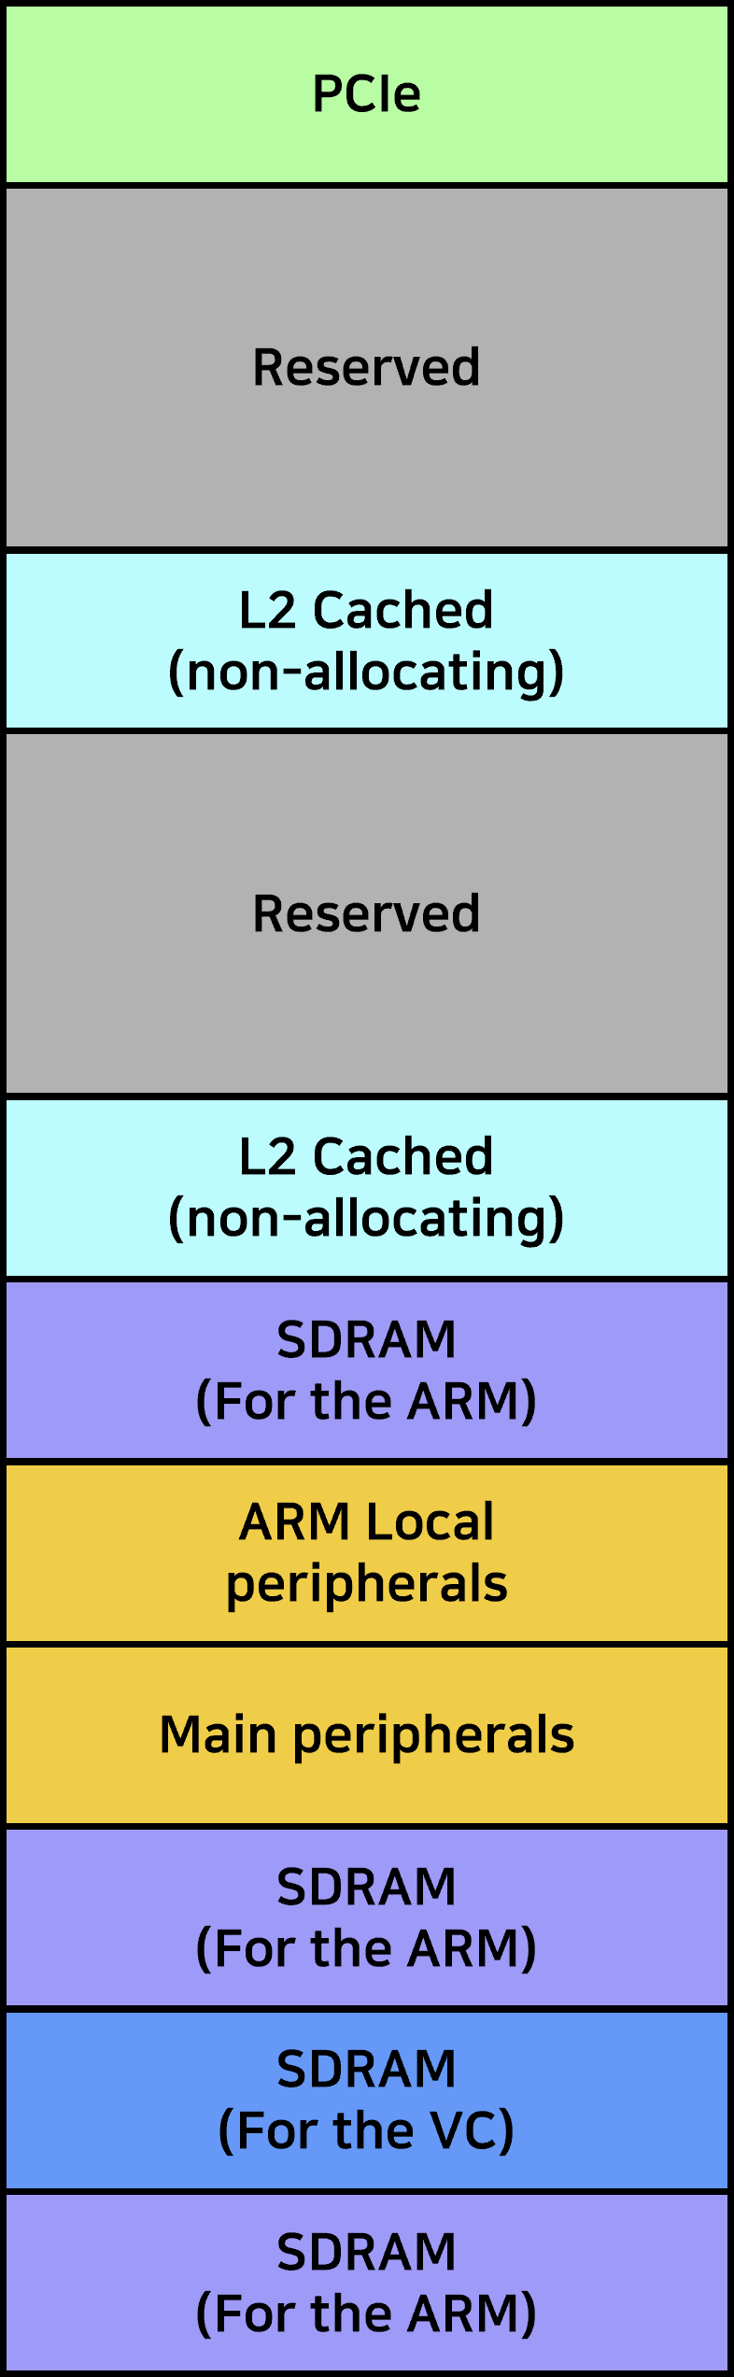
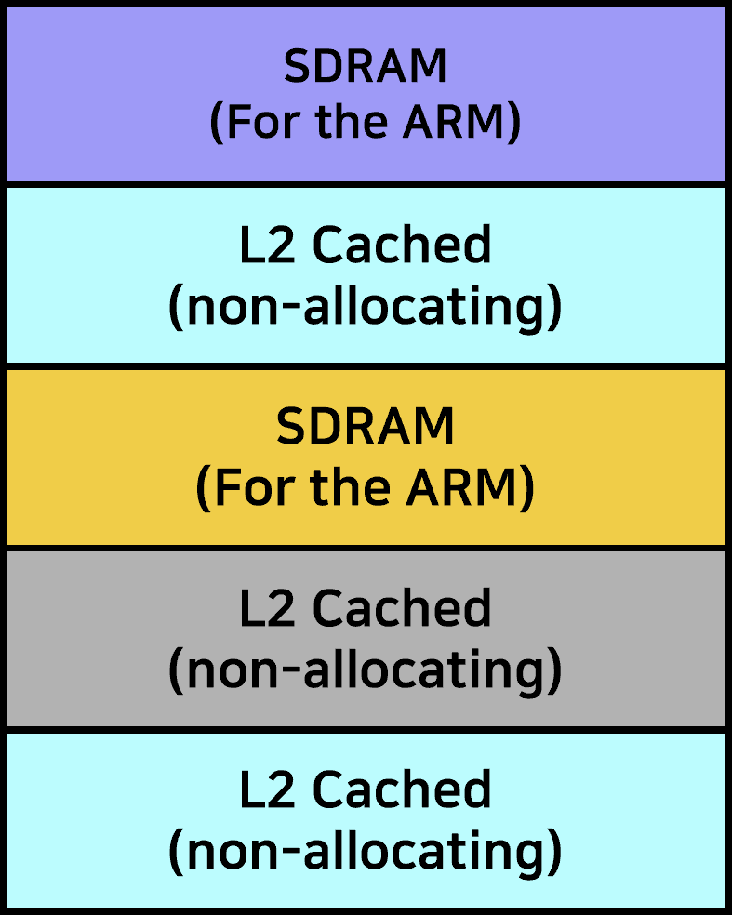
0x7_FFFF_FFFF
0x7_FFFF_FFFF
0x6_0000_0000
0x6_0000_0000
0x5_0000_0000
0x5_0000_0000
0x4_C000_0000
0x4_C000_0000
0x4_8000_0000
0x4_8000_0000
0x4_7C00_0000
0x4_7C00_0000
0x4_4000_0000
0x4_4000_0000
0x4_0000_0000
0x4_0000_0000
0xFFFF_FFFF
Padding
registers
0xC000_0000
0x8000_0000
0x7C00_0000
0x0_4000_0000
0x0_4000_0000
0x4000_0000
0x0000_0000
0x0_0000_0000
0x0_0000_0000
Legacy Master view
of Address Map
Full 35-bit Address Map
ARM view of the Address Map
In “Low Peripheral” mode

Slide 5
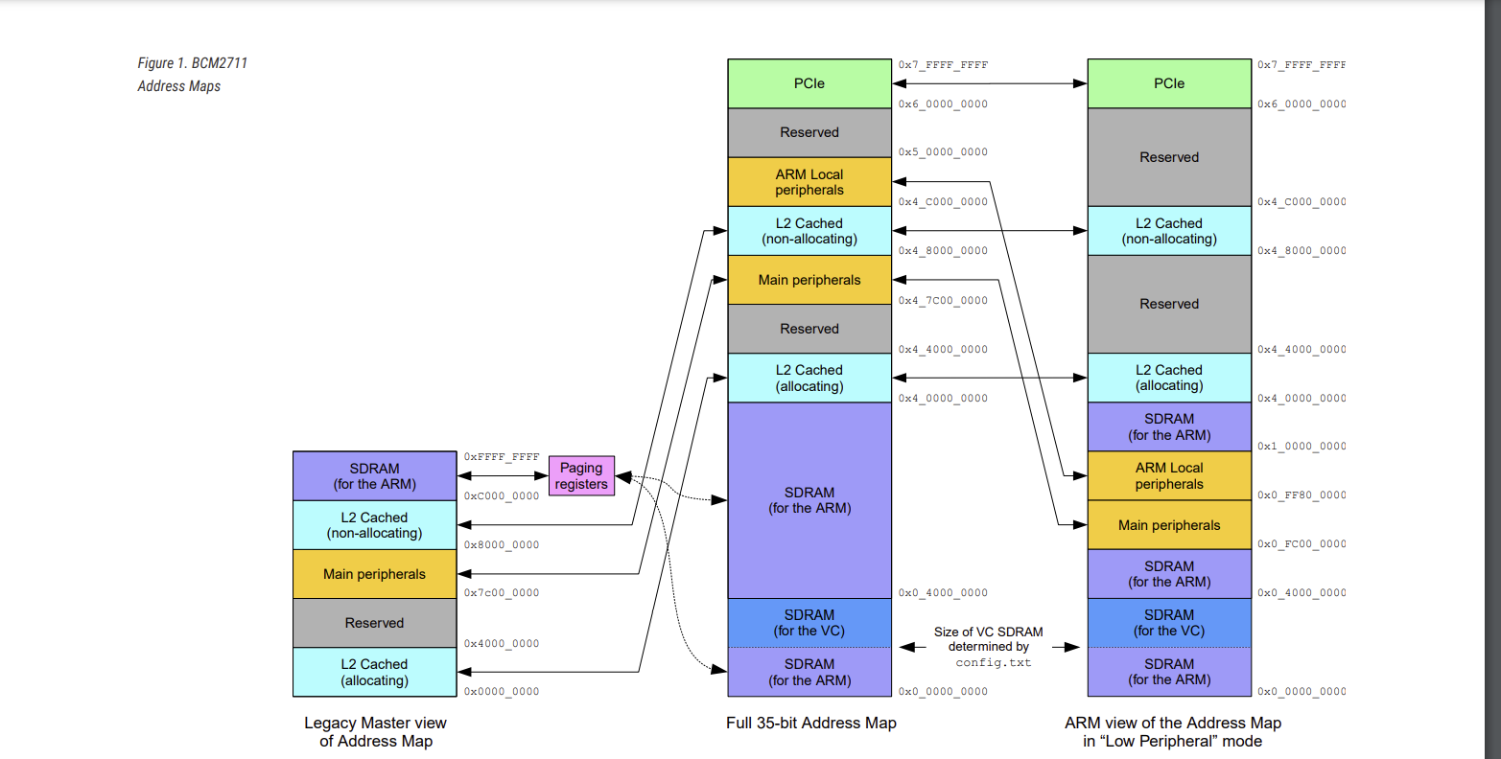

Slide 6
PCIe
PCIe
Reserved
Reserved
ARM Local
peripherals
L2 Cached
(non-allocating)
L2 Cached
(non-allocating)
Main peripherals
Reserved
Reserved
L2 Cached
(non-allocating)
L2 Cached
(non-allocating)
SDRAM
(For the ARM)
SDRAM
(For the ARM)
SDRAM
(For the ARM)
ARM Local
peripherals
L2 Cached
(non-allocating)
Main peripherals
SDRAM
(For the ARM)
SDRAM
(For the ARM)
L2 Cached
(non-allocating)
SDRAM
(For the VC)
SDRAM
(For the VC)
L2 Cached
(non-allocating)
SDRAM
(For the ARM)
SDRAM
(For the ARM)

Slide 8
